Slide 1
The Avocado Project
UCF Data Analytics & Visualization Bootcamp
Dawn Salisbury, Chrissy Suckow
Katherine Manning, Sofia Sotillo

Slide 2
A Little Background…
Avocados are VERY popular in the US: Guacamole, Sushi, Avocado Toast…
The Superbowl is “one of the leading days in avocado consumption. Nearly 300 million avocados are consumed during the game” (Darwin, 2020)
There is specific marketing research & insights on The Hass Avocado Board site for Millennials, Hispanic & Non-Hispanic populations
If you don’t like avocados there is something severely wrong with you… you really should get that checked out…

Slide 3
Our team sought to get to the creamy, delicious, seeded world of avocados in the US to answer the following Questions…
Who exports the most avocados to the US?
Does the month of year affect avocado sales or prices?
What is the popularity of avocados within the United states sold by region?
Can the type of avocado offered affect sales?
How do the prices of conventional avocados compare to organic?
How do the units sold compare between conventional and organic avocados?

Slide 4
So, to answer those questions we chose to focus on the following things:
Hass avocados
Datasets from 2015 – 2020 based off The Hass Avocado Board
https://hassavocadoboard.com/
https://www.kaggle.com/alanluo418/avocado-prices-20152019
H_{A}: Our Hypothesis is the consumption of avocados changes according to several factors.
H₀: There is no difference in the consumption of avocados throughout the year, despite any factors.
p<0.05

Slide 5
Who exports the most avocados to the US?
H₀: There is NO significant difference in the amount of avocados exported from all the countries/ states to the US: All relatively same.
H_{a}: There IS a significant difference in the amount of avocados exported from all the countries/ states to the US: NOT the same amounts.
So we analyzed the data: Total Volume Data (lb) from 2017 – 7/14/2020
Performed chi squared test to test for significance on categorical totals from each country.
Critical Value is 9.49
Chi Squared Value is 21403475432.32
p-Value is 0.0
Since the chi square value exceeds the critical value AND the pvalue is 0, we can assume that the results are statistically significant.

Slide 6
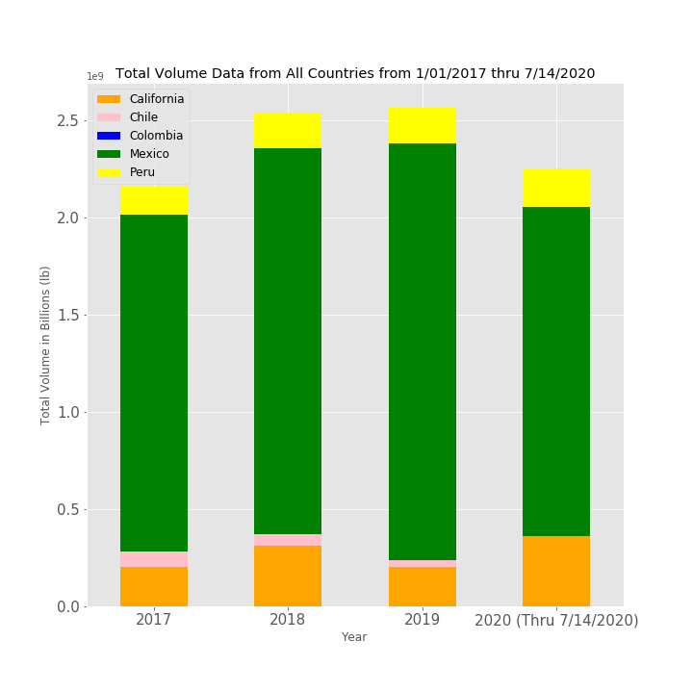
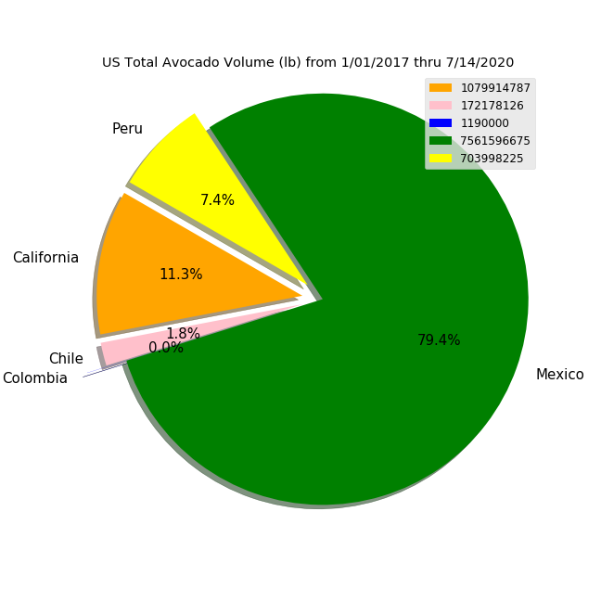
Who exports the most avocados to the US?
In a word: Mexico, followed by Peru. California is our 2nd largest producer to Mexico, but they do not ”export” to us, as they are a part of the US.

Slide 7
Who exports the most avocados to the US? Cont.
A couple words about California:
Research shows that Hass avocados are also grown in Florida & Hawaii (Shahbandeh 2020)
Hass Avocado data only includes California, because they account for >90% of US avocado output - they accounted for 93% of US avocado output in 2018 (USDA 2020)
Per the Agricultural Marketing Resource Center: “The United States is a net importer of avocados from Mexico. Mexico supplied most of the avocados imported into the United States in 2017. In 2017 the United States imported $2.6 billion in fresh avocados and exported approximately $28,500 in fresh avocados (ERS 2018).”
California was recently approved to export to China!

Slide 8
Does the time of year affect avocado sales and price?
H₀: The month of the year does not affect the sales volume or average sales price of an avocado.
H_{A}: Avocado sales are higher in certain months of the year, and average price per avocado is lower.

Slide 9
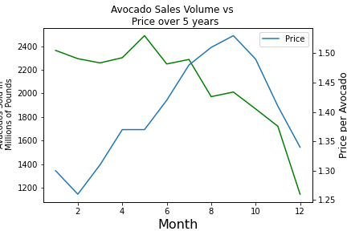
2014-2019 Avocado Sales Volume in Millions of Pounds and Average Price Per Avocado
Avocado sales volume is higher in the first half of the year.
May is the month with the highest avocado sale, most likely due to Cinco de Mayo
Average avocado prices are lower in the winter/spring months, higher in summer/fall months
Possible reasons for further investigation:
Supply/demand
Peak avocado growing seasons
Severe weather impacts/recalls

Slide 10
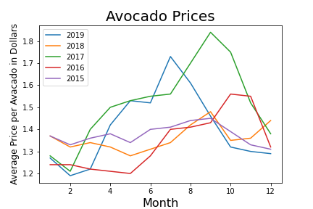
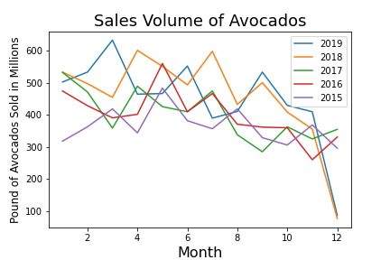
Breakdown of Trends for Each Year of Avocado Prices and Sales Volume
When analyzed for individual year compared to other years, a clear conclusion cannot be made for the month with the highest sales volume or the month with the lowest avocado price.

Slide 11
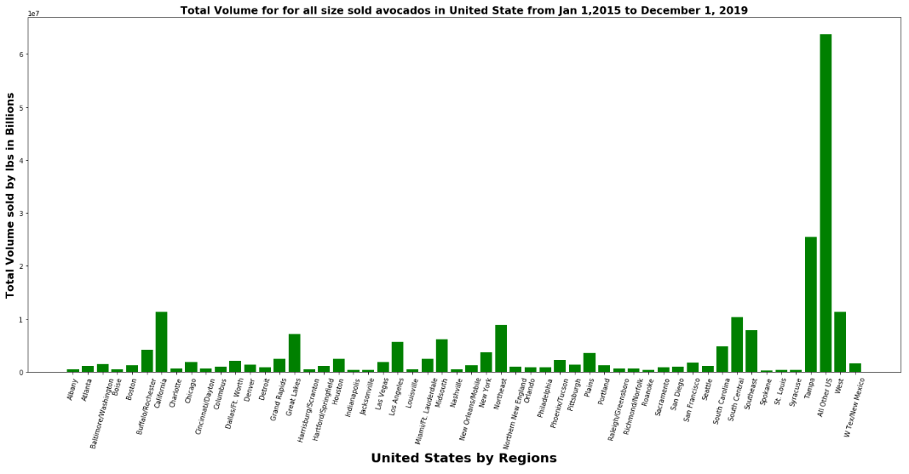
What is the popularity of avocados within the United states sold by region?
Total bs. of Hass avocados sold in the U.S. 24,960,842,913

Slide 12
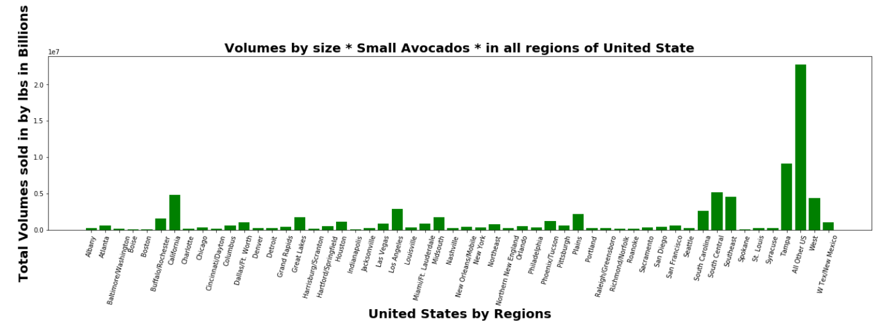
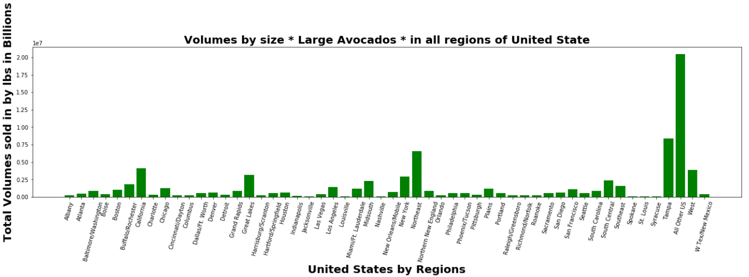
Can the type of avocado offered affect sales?
Volumes by type of avocado Small: 8,068,993,745 Large:7,926,564,441

Slide 13
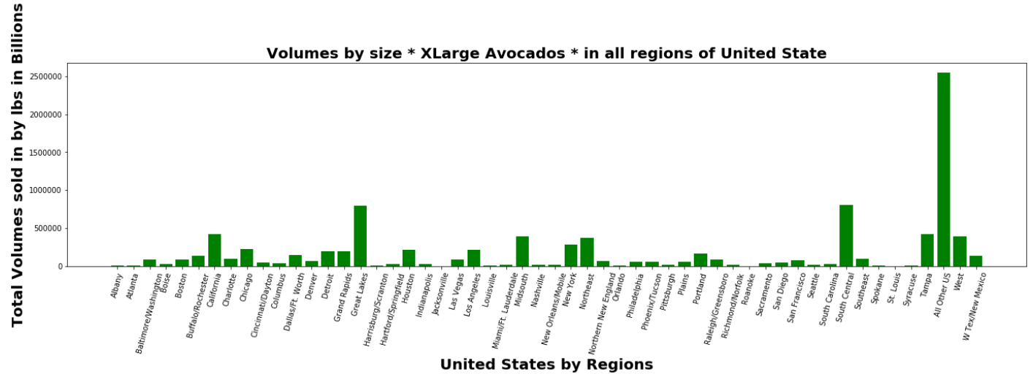
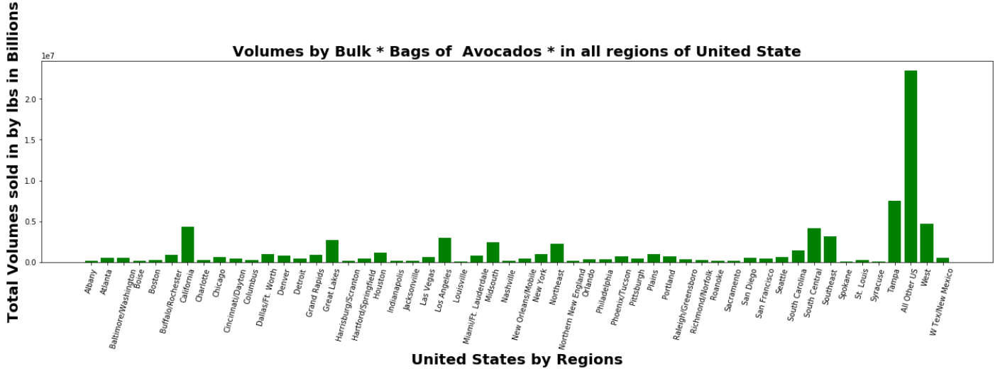
Can the type of avocado offered affect sales?
Volumes by type of avocado X-Large: 605,441,564 Bulk: 8,357,394,158

Slide 14
How do the prices of conventional avocados compare to organic?
H_{A}: In a comparison of units sold, organic avocados will average a higher cost than conventional avocados.
H₀: When comparing units sold, there will be no difference between cost of conventional and organic avocados.
How do the units sold compare between conventional and organic avocados?
H_{A} :Looking at the units sold, conventional avocados will average a higher total volume sold than organic avocados.
H₀: Comparing all units sold, there will be no difference between the total volume sold for organic and conventional avocados.

Slide 15
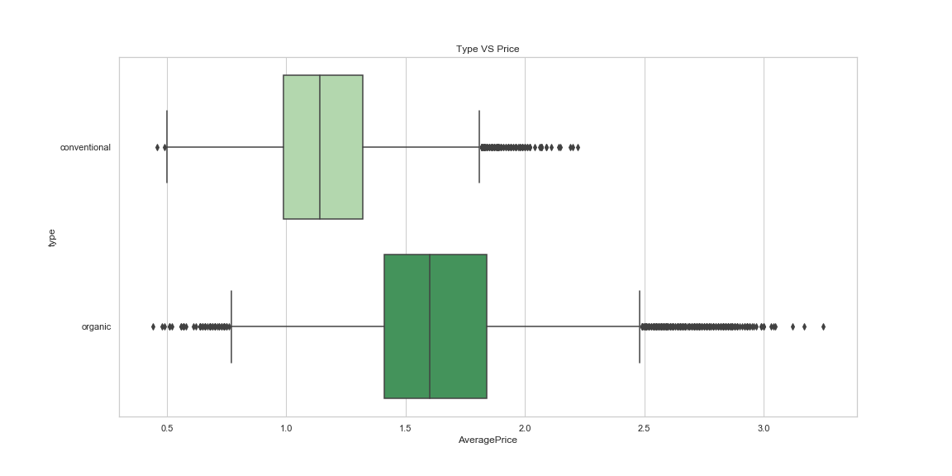
To start us off, lets split up our options
Organic Avocados have a mean of $1.63
There is a 33.69% difference between them
Let's see what more we can learn from the data!
Conventional Avocados have a mean of $1.16
The average price of an Organic Avocado is higher (Duh..)

Slide 16
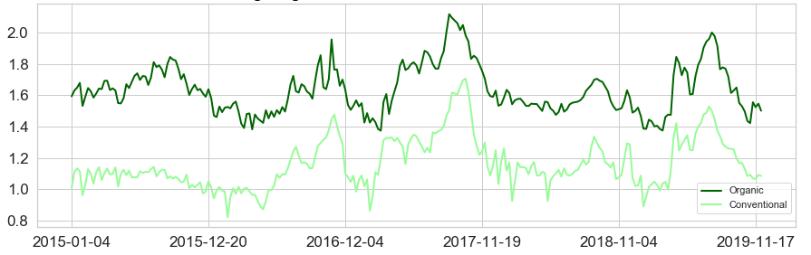

Conventional vs Organic
Avocado Facts!
"Avocado prices have rocketed in recent years by up to 129%, with the average national price of a single Hass avocado reaching $2.10 in 2019, almost doubling in just one year.“
[Ash, 2019]
According to the most recent department of agriculture weekly retail price report, the average national price of a Haas avocado was $2.10 July 5, compared to $1.17 from the July 6, 2018, report.
[Tyko, 2019]
The word “avocado” didn’t appear in the lexicon until the US Department of Agriculture decided that “avocado” was much more appealing than “alligator pear.”
[Wilson, 1963]
Prices have consistently changed through out the time period this data provides.
Organic Avocados peeked at $3.25 and Conventional at $2.22
2017 saw the highest spike in Avocado prices
Overall, Organic Avocados remain more expensive compared to Conventional

Slide 17
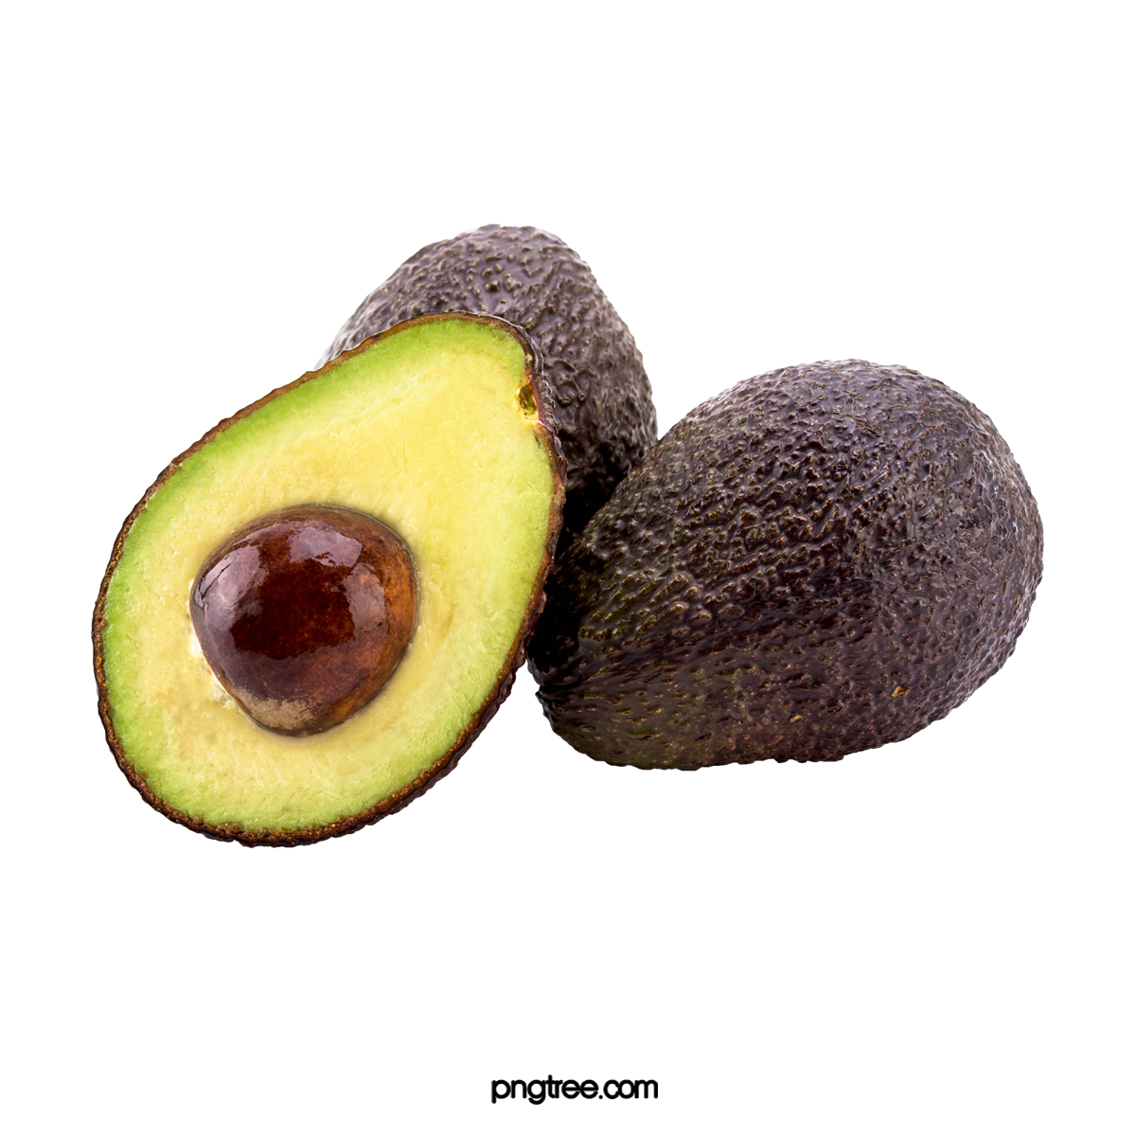





Seasons - Seasons are a HUGE reasons price fluctuate. However, Avocado season is primarily year-round! Most Avocados come from California or Mexico as export data showed. California’s growing season is from February to September. Mexico harvests and grows all year long. Looking at this seasonal fact may be a reason why we see prices peek during the spring, fall, or winter!
Trade - As the government renegotiates specific trade deals, Avocados could take a hit. Imposing tariffs on imported Avocados would not only raise the product price for suppliers, but it would also increase the cost for consumers too. In addition, trade deals could involve seasonal restrictions that would impact the supply and demand, and ultimately raise avocado prices.
Drought, Heavy Rains, and Fire - In addition to excessive heat, drought can also impact crop supply and cause prices to soar. While most of California is no longer in a drought, 44% of the state still sees drought conditions. That said, the drought has had little impact on this year’s produce and was more of a concern in year’s past. Drought followed by heavy rains can also impact avocado supply. In recent years, California has seen some heavy rainfall during the winter months, which has ultimately affected the price of avocados.
Excessive Heat - Heat ties into seasons in a way but what this fact is focusing on is heat waves. In 2016, a massive heat wave which affect California and Mexico contributed to the high cost of Avocados for ALL of 2017. [Quinn, 2018] This weather information helps shine a light on why some of our prices were shooting up during 2017!
Now that we see time of year and type can affect prices.
What else could be playing into all this data?
[Quinn, 2018]

Slide 18
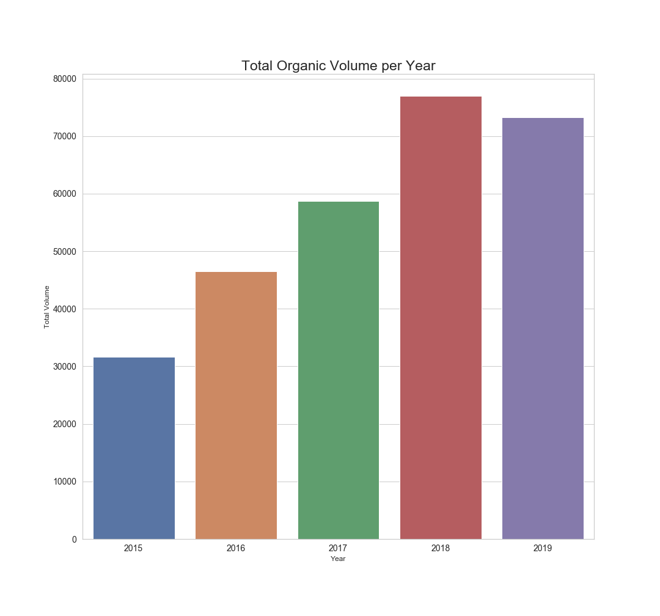

Let's split things up again
Our Total Volume purchased of Organic Avocados since 2015 has gone up by an estimated 40,000 units
In 2018 we see an estimated 7,000-unit spike in sales.
We can determine that Organic sales have steadily increased on a yearly basis.

Slide 19
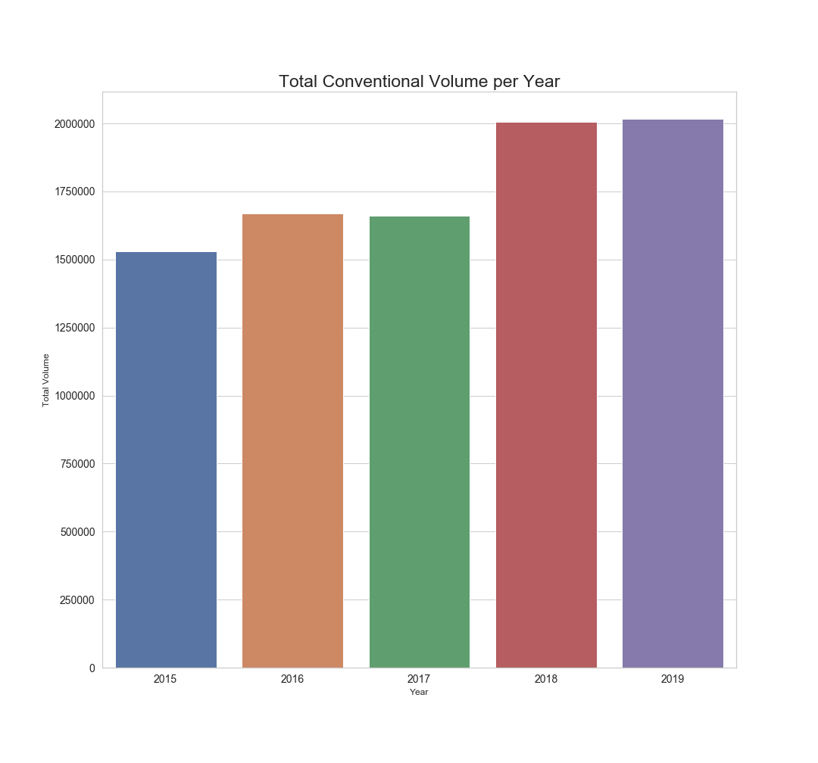
Now let's look at Conventional!
There's an estimated 2,000,000-unit difference between how many Conventional Avocados sold in 2018 compared to Organic
In 2018 there was an estimated 450,000-unit increase in sales.
Conventional Avocados were selling roughly 27% times more than Organic in 2019.

Slide 20
Conclusions/ Observations
We expected a difference between the exporters to the US, but we did not expect SUCH a significant dominance by Mexico, 79.4% of total volume for 2017-7/14/2020!
We thought the US exported to other countries, but it is very minimal. Our original question covering this had to be dropped based on research.
To find seasonal sales information, dates, total volume sold, and the average price of the avocados were needed. This information showed that time of year could affect volume sold, but more research needed to be made for other factors including: supply and demand, weather, and holidays.
When the individual years were analyzed compared to sales, a conclusion could not be made for the month with the highest sales or the month with the lowest avocado prices.
Hass avocado board identified 54 top market regions within the United States, the data provided included all sizes and bulk distributions.

Slide 21
Conclusions/ Observations cont.
The United states prefers the small avocados
After reviewing the dataset we found a large discrepancy with the total lbs. listed, it did not reflect the actual for the product count provided in the data.
We were amazed to find a discrepancy in the data of the avocado file. Mostly around the data from Detroit it was off over 2,000,000 lbs .
If we think back to the box plot, we can see that Organic cost roughly 34% more than Conventional.
When looking over their average volume sold, we see that in 2019 Organic Avocados roughly sold 72,000-units, Conventional Avocados sold around 2,000,000-units. Taking these two averages, Organic Avocados sold roughly 186% more than Conventional.
After cleaning, compiling, and organizing the relevant datasets we can see that Organic Avocados are consistently more expensive than Conventional Avocados.
Conversely, we see that Conventional Avocados have a higher average volume sold than Organic. These results pose an inverse relationship between cost and units sold ultimately suggesting that the lower cost leads to higher sales.

Slide 22
Sources Cited:
Darwin, C (2020, January 15) Host Your Big Game Celebration With Avocados From Mexico's Guac Nation Party Pack. Retrieved from https://www.prnewswire.com/news-releases/host-your-big-game-celebration-with-avocados-from-mexicos-guac-nation-party-pack-300987342.html
Shahbandeh, M (2020, May12) Production of avocados in the United States in 2019, by state. Retrieved from https://www.statista.com/statistics/610460/production-avocados-us-by-state/
USDA (2020, March 20) U.S. avocado demand is climbing steadily. Retrieved from https://www.ers.usda.gov/data-products/charts-of-note/charts-of-note/?topicId=14849#:~:text=U.S.%20avocado%20demand%20is%20climbing%20steadily&text=Total%20U.S.%20production%20in%202018,avocado%20output%20in%20that%20year.
AGMRC (2018, October) Avocados. Retrieved from https://www.agmrc.org/commodities-products/fruits/avocados#:~:text=Exports%2FImports,fresh%20avocados%20(ERS%202018).
Zang, Jing (2020, April 30) California Hass Avocados Approved for Import into China. Retrieved from https://www.producereport.com/article/california-hass-avocados-approved-import-china

Slide 23
Sources Cited cont.
Ash, A. (2019, November 04). Avocado prices have boomed in the last decade - here's why they are so expensive. Retrieved July 22, 2020, from https://www.businessinsider.com/why-avocados-are-so-expensive-2019-10
Jessie Quinn More Articles July 31, 2. (2018, July 31). Here's Why Avocados Are so Expensive Right Now. Retrieved July 22, 2020, from https://www.cheatsheet.com/culture/why-avocados-are-so-expensive.html/

Slide 24
Thank You!

